Slide 1
Some sample outputs
Manual Counting
Predicted Counting
Original image
Segmented image

Slide 2
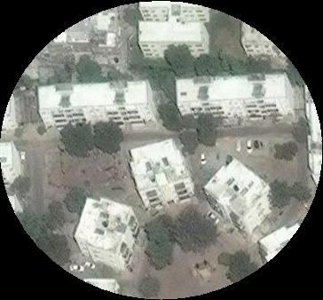
Manual - 11
Predicted - 15

Slide 3
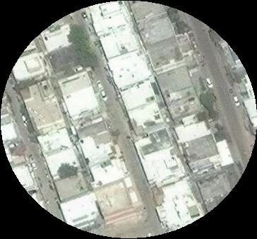
Manual - 17
Predicted - 10

Slide 4
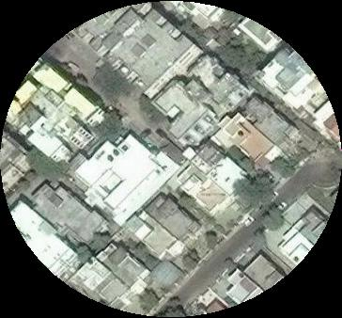
Manual - 18
Predicted - 24

Slide 5
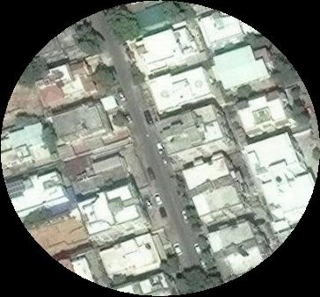
Manual - 19
Predicted - 22

Slide 6
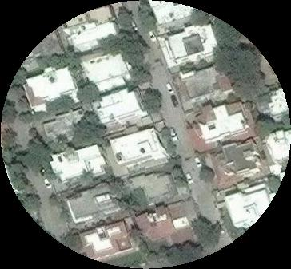
Manual - 21
Predicted - 25

Slide 7
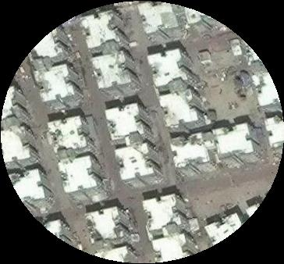
Manual - 25
Predicted - 29

Slide 8
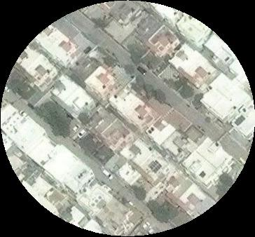
Manual - 12
Predicted - 9

Slide 9
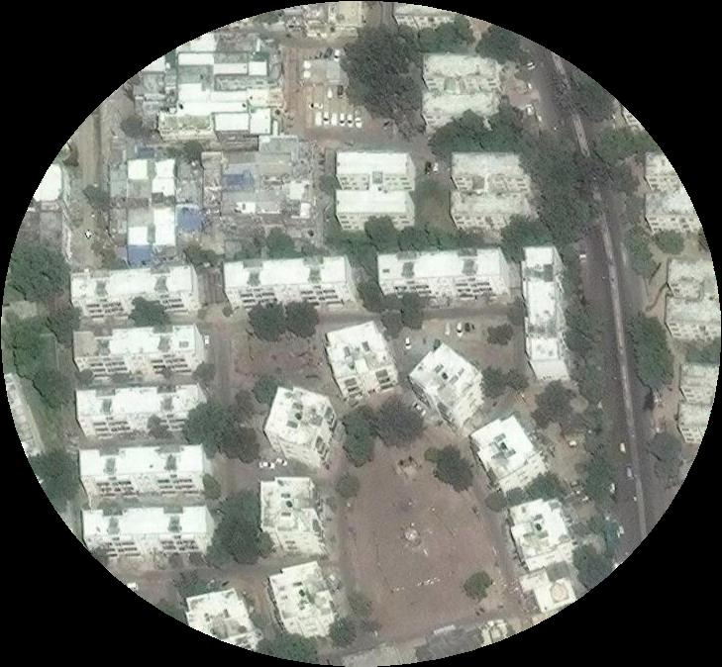
Manual - 36
Predicted - 42

Slide 10
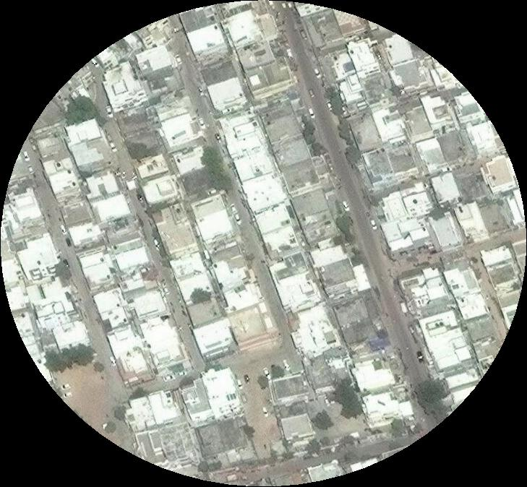
Manual - 60
Predicted - 30

Slide 11
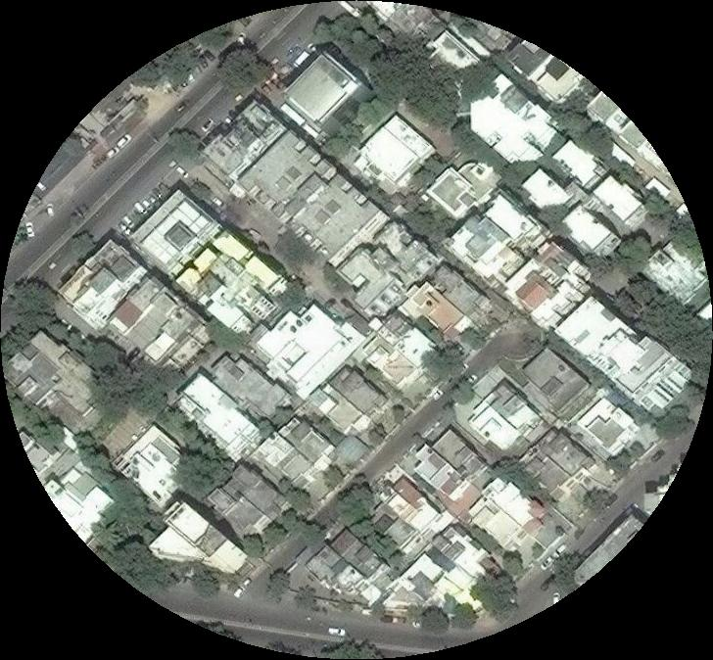
Manual - 55
Predicted - 52

Slide 12
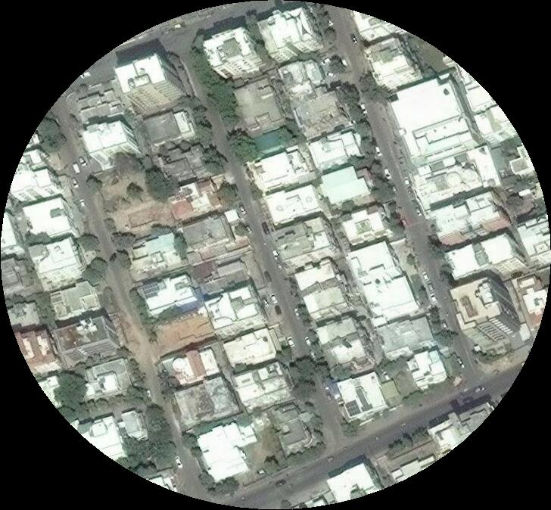
Manual - 64
Predicted - 69

Slide 13
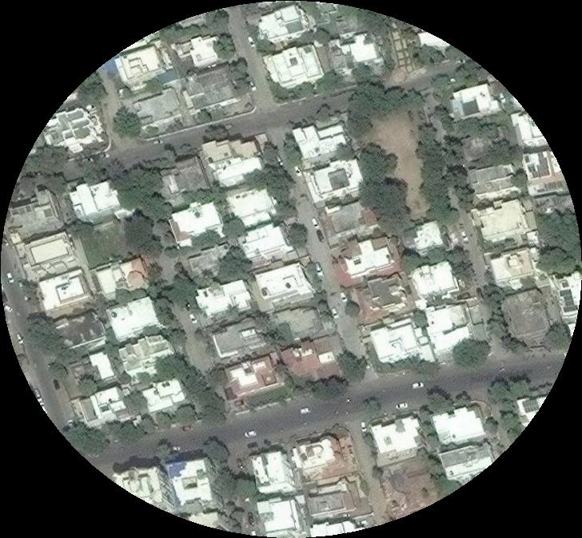
Manual - 59
Predicted - 62

Slide 14
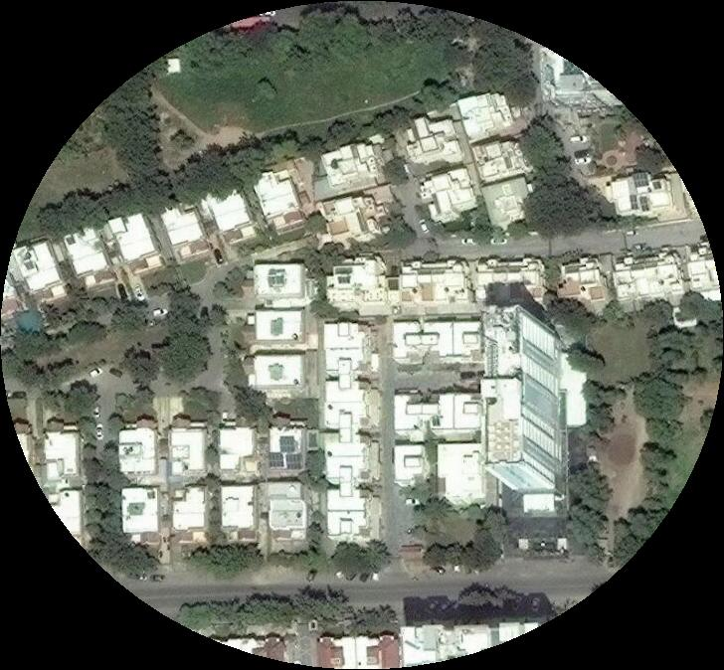
Manual - 35
Predicted - 18

Slide 15
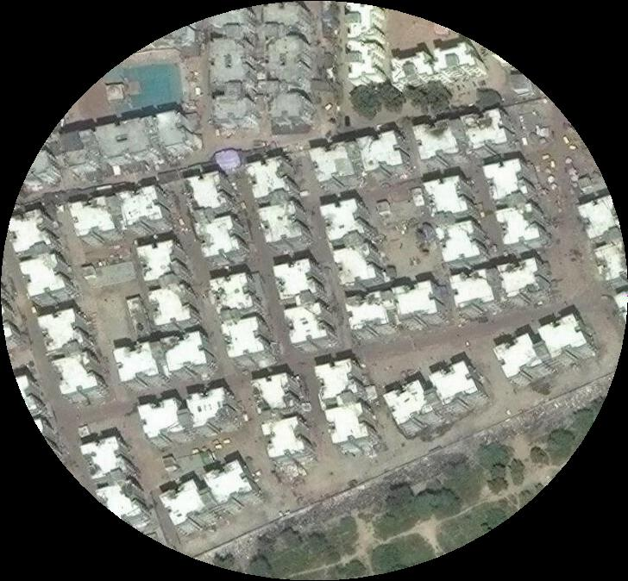
Manual - 63
Predicted - 68

Slide 16
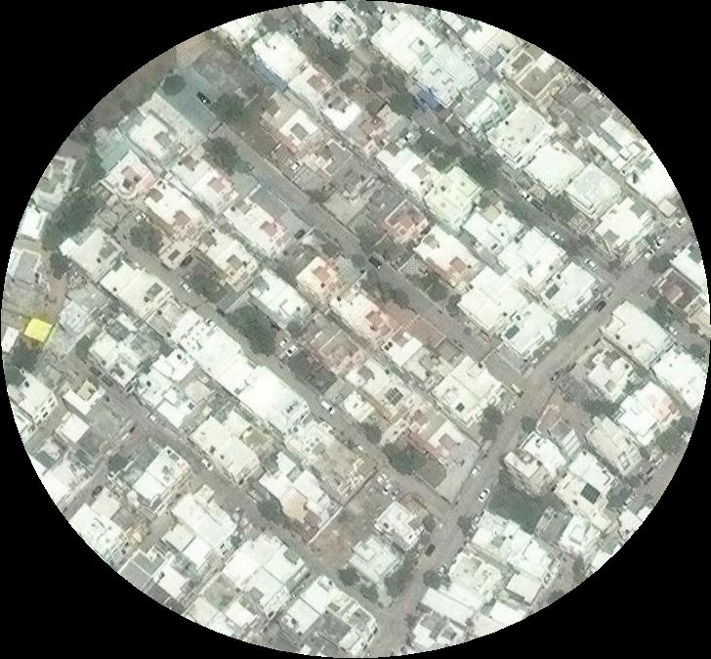
Manual - 40
Predicted - 25

Slide 17
Manual - 37
Predicted - 36

Slide 18
Manual - 17
Predicted - 16

Slide 19
Manual - 49
Predicted - 42

Slide 20
Manual - 16
Predicted - 13

Slide 21
Manual - 44
Predicted - 40

